Slide 1
Measuring the User, Not the Model: Critical AI Literacy and the Verification Frontier
Derek Briggs
University of Colorado Boulder
Society for the Study of Measurement Meeting
Edinburgh, Scotland
June 24, 2026

Slide 2

I Have Chosen the Red Pill
Notes:
Describe evolution of AI use in teaching and research. Incredible potential, but still a jagged frontier
Requires careful exploration & experimentation
Best place to do this? Where you have sufficient domain expertise to use critically
Courses you have taught multiple times pre AI are an ideal sandbox!

Slide 3
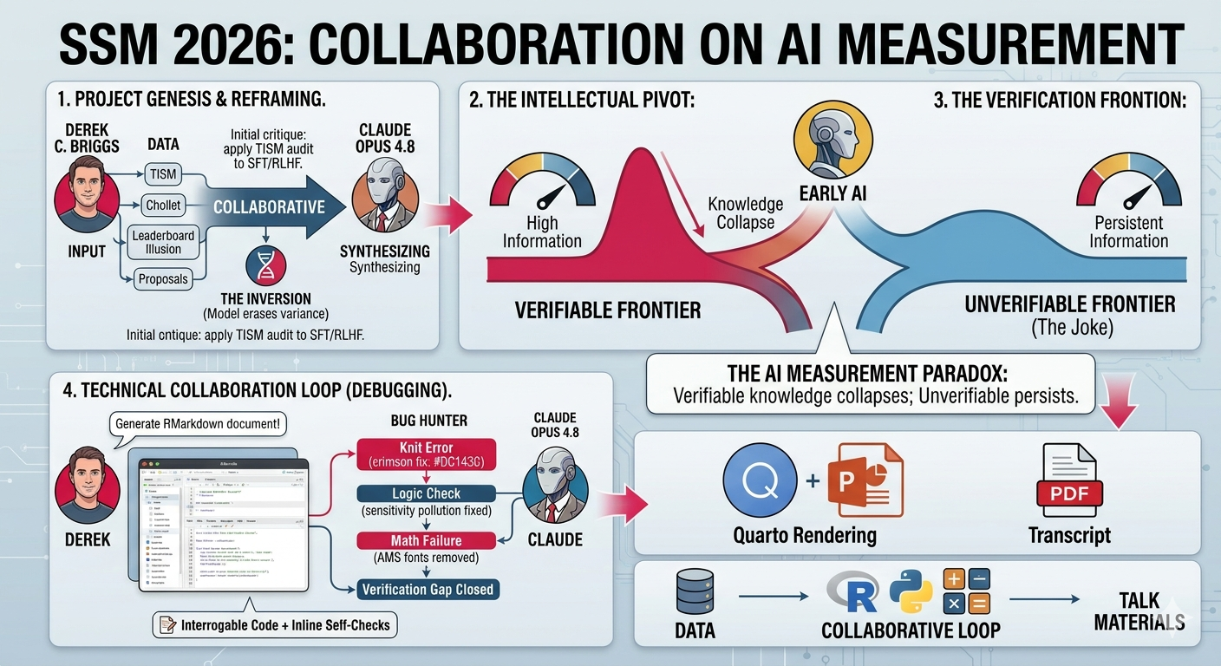
A Meta Example: How I Work with AI

Slide 4
The Jagged Frontier of LLMs
My prompt to Claude: Write a super funny joke about pelicans.
Claude (Opus 4.6): A pelican walks into a bar. The bartender says, “Why the big bill?”
A jagged frontier: LLMs can solve problems that would stump a genius, but they struggle to deliver a funny joke.

Slide 5
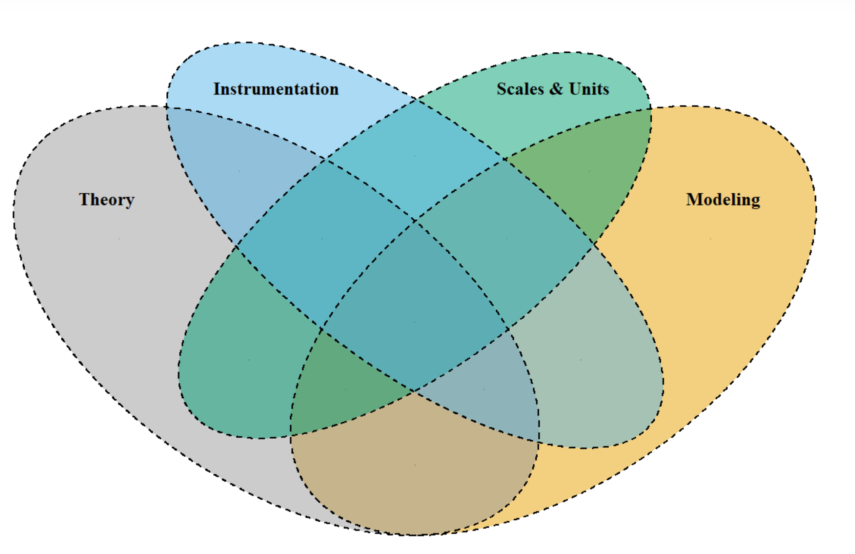
Measuring an LLM’s “Intelligence?”
TISM Framework for Measurement (Briggs, Maul & McGrane, 2025)
Not entirely impossible with respect to I, S, and M
But there is a deeper problem…
No substantive theory: measurement is premised on variability—LLMs are being engineered to eliminate this!

Slide 6
A Pivot
Unwise to treat LLMs as objects of measurement.
The variability amenable to measurement come in the variability of how humans interact with them.
Measure human attributes, evaluate model capabilities
Constructs of interest: dimensions of AI Literacy—domain general habits of mind.
Critical literacy: the ability to detect and repair a plausible-but-wrong AI output that is not easily verified.

Slide 7
Measuring Critical AI Literacy
Setup
Stimulus: a response from an LLM to a prompt provided to it by a human. The response looks “correct,” but it is not.
X = the decision/judgment reached by a person after interacting with AI
X = 1 if “correct” or “successful”
X = 0 otherwise

Slide 8
Two Types of LLM “Item” Domains
Domain 1: Cheaply verifiable (v = 1)
A statistics or coding task, a factual question.
Ground truth exists.
Domain 2: Unverifiable or Expensively verifiable (v = 0)
A funny story for a dinner party. A successful presentation.
No ground truth a prior, can only be judged post hoc

Slide 9
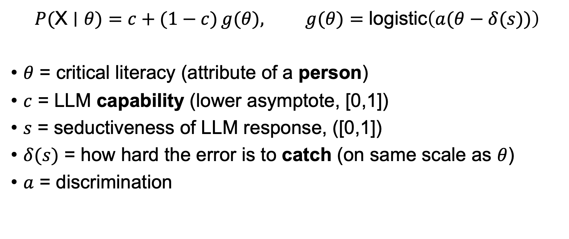
A Hypothetical Measurement Model
$$P(\text{X}∣θ)=c+(1−c) g(θ), g(θ)=\text{logistic}​\left(a(θ−δ(s))\right)$$
$θ$ = critical literacy (attribute of a person)
$c$ = LLM capability (lower asymptote, [0,1])
$s$ = seductiveness of LLM response, ([0,1])
$δ(s)$ = how hard the error is to catch (on same scale as $θ$)
$a$ = discrimination

Slide 10
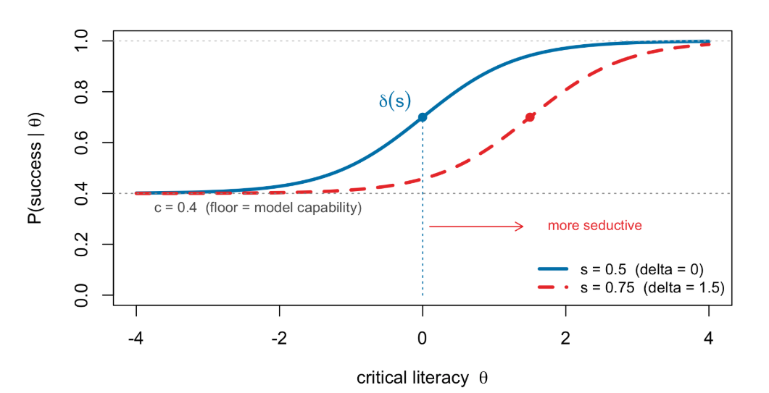
Item Characteristic Curves

Slide 11
Simulation
Base LLM in both domains: c = .50, s = .45
After multiple generations of LLM improvement…
s goes up by same amount in each domain to .62
for domain v = 1, c converges to a ceiling near 1 (.96)
for domain v = 0, c shows very small increase (.50 to .55)
How does the psychometric information we get from a single item in each of these domains change?

Slide 12
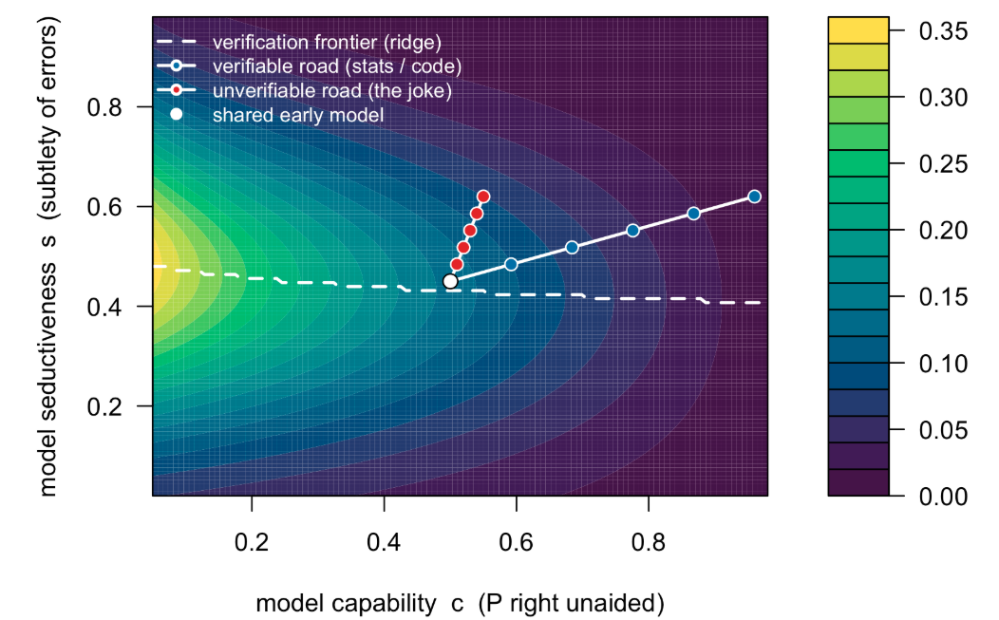
Notes:
Note that the ridge (dashed white line) represents the value of s that maximizes information for a given value of c.

Slide 13
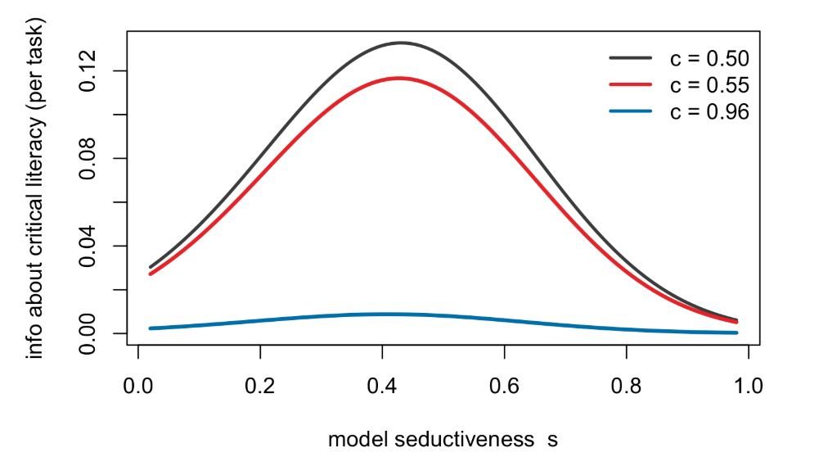
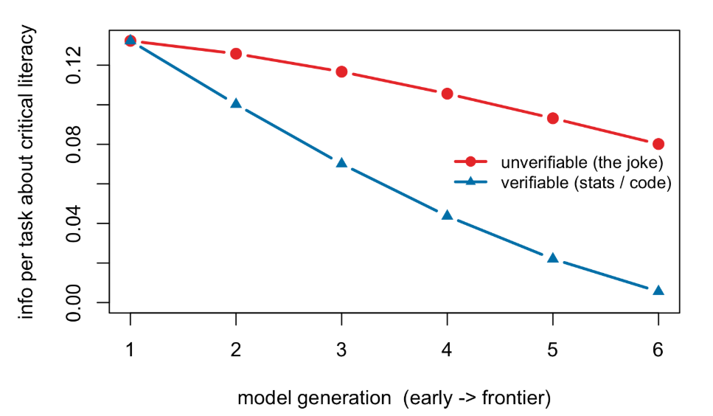
Hard to Verify Domains are Better for Measuring Critical Literacy

Slide 14
Critical AI Literacy is most measurable where AI on its own can help the least
Model | c | s | Avg Info per item | Number of items needed for reliability = .80
Shared Early LLM | .50 | .45 | .1323 | 30
Frontier LLM in verifiable domain (code) | .96 | .62 | .0056 | 719
Frontier LLM in unverifiable domain (jokle) | .55 | .62 | .0801 | 50

Slide 15
The Instrument Fights the Measurer
You measure the human through a non-stationary instrument (an LLM) engineered to compress the construct’s variance.
Penmanship in the age of the word processor; navigation in the age of GPS.
A lower asymptote forfeits Rasch’s specific objectivity — AI literacy comparisons are non-invariant to the model/task used.
Open question: does unverifiable-domain literacy persist or erode as s increases with c hitting a plateau.

Slide 16
Summary
Measuring LLM capability as a latent trait: largely a category error in absence of substantive theory
Measurement still matters— it is relocated: from the LLM to the human, and made harder to accomplish by the LLM.
AI literacy constructs are socially constructed and in flux — we are at the thermoscope stage.
The jump-off: a design that tests compression vs. amplification of human variance as models improve.

Slide 17
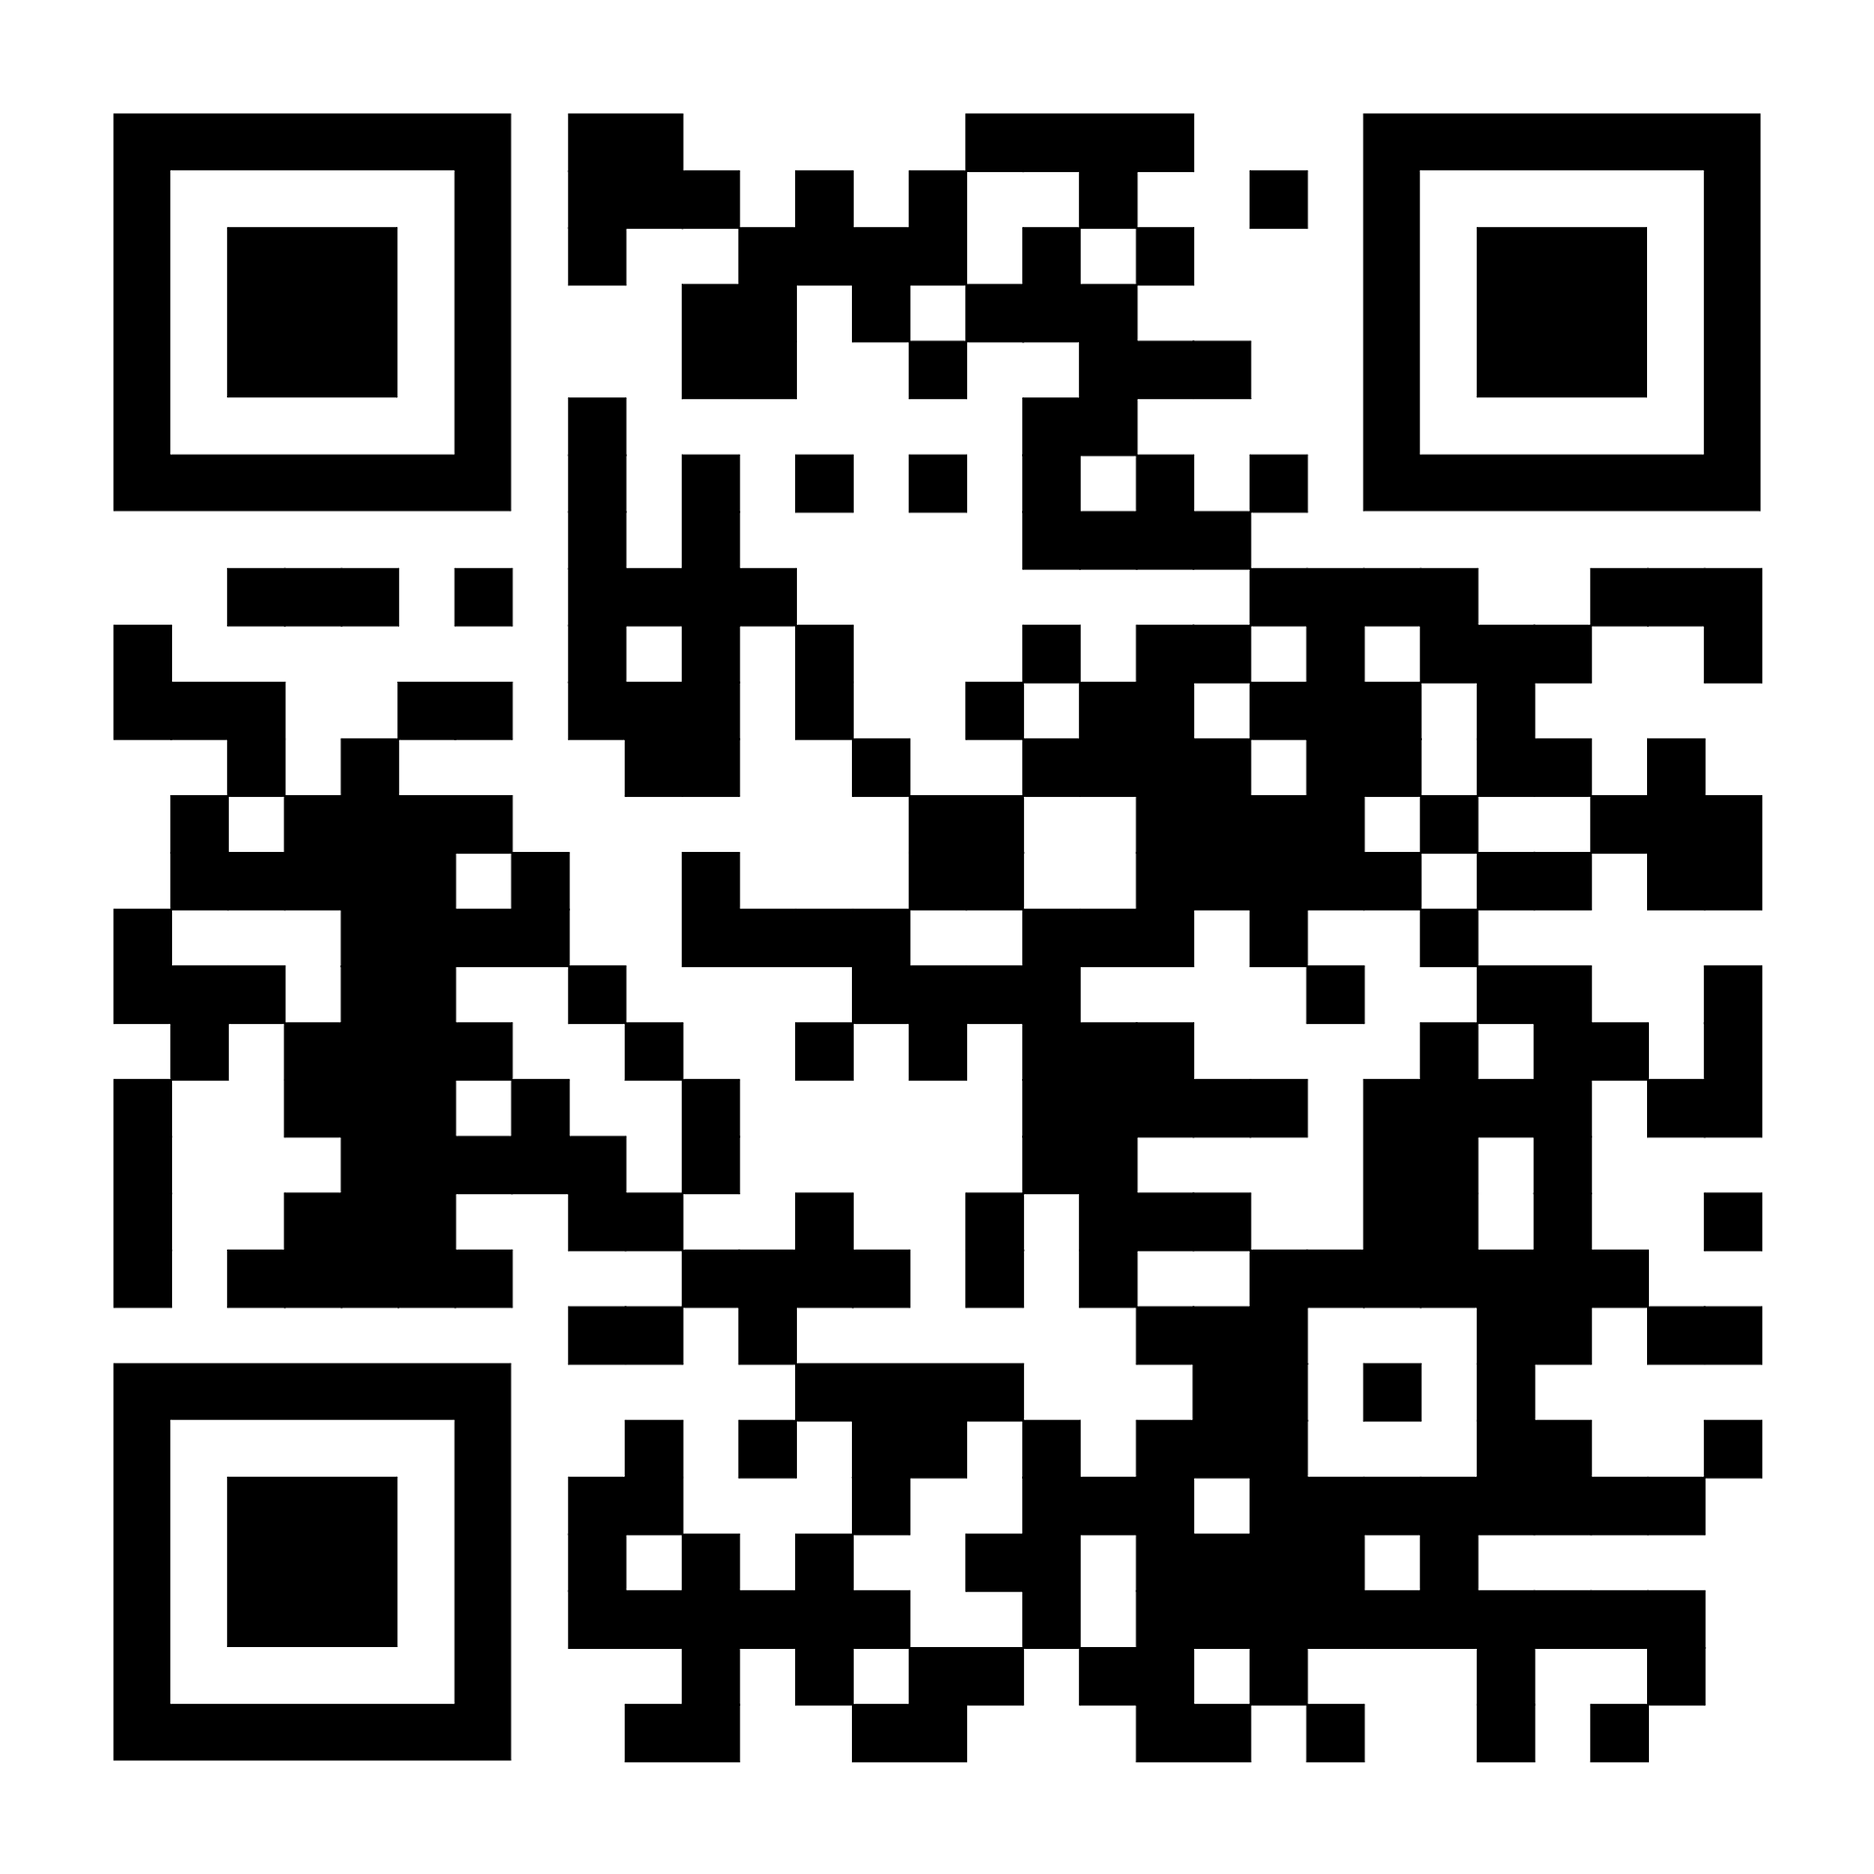
Thank You!
For details on simulation, transcript of my interactions with Claude Code, slides see
For blog posts on AI Literacy and Informed Skepticism see https://derekcbriggs.github.io/blog.html
Or just email me at derek.briggs@colorado.edu

